Slide 1
The Trail by VINCI Construction – 2nd edition
2019

Slide 2
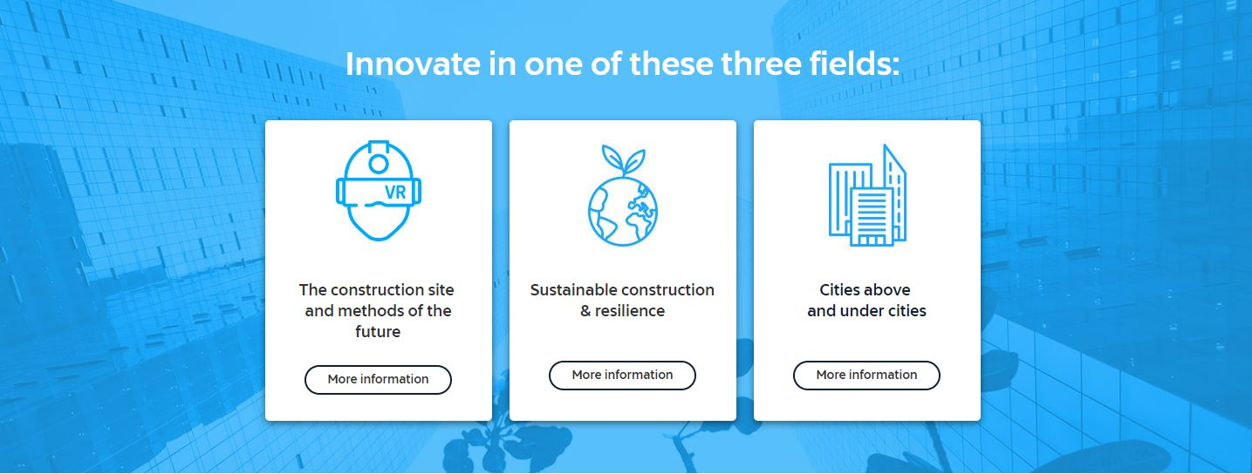
IMAGINE tomorrow’s construction industry
How should companies working in the construction sector integrate new technologies, and how can they develop and adapt to meet society’s needs and improve people’s quality of life?

Slide 3
WHAT IS THE TRAIL BY VINCI CONSTRUCTION?
The Trail by VINCI Construction is an international innovation challenge organised in 3 phases:
Goals:
Attract talents to recruit the best.
Be recognised as a dynamic company and an innovative employer.
Gather ideas and develop initiatives that address the company’s issues.
Create and maintain a special connection with our target schools and universities around the world.
Prizes: a trip, sports equipement, smart devices… and the opportunity to join the Group!
PART #1
ONLINE CHALLENGE
Online creativity and innovation challenge open to all applicants
PART #2
LOCAL CEREMONIES
Local award ceremonies to select finalists in each country
PART #3
INTERNATIONAL FINAL & SPORTS CHALLENGE
Pitch at Léonard & sports challenge in a superb natural setting for the finalist teams

Slide 4
THE TRAIL 2020 SCHEDULE
LOCAL PRE-SELECTION
ONLINE VOTE
CHALLENGE LAUNCH
PROMOTION
END OF THE ONLINE CHALLENGE
CALL FOR PROJECTS
sent to VINCI Construction target schools/universities around the world
School presentations
(conferences, afterworks)
3 SLIDES FILE + VIDEO PITCH
Students form their 4-person mixed team and submit their proposals based on one of the subjects listed
PRE-SELECTION/VOTE
At the end of the online challenge, a jury of identified internal experts vote and select the best concepts.
Internal & external promotion
2019/07/01
01/03/2020
02/03 TO 16/03/2020
3 teams per country | zone
Online
COACHING & OPERATIONAL SPONSORSHIP
Train to pitch with professionals & deeper exploration of the subject for the pre-selected teams with an internal operational coach who joins the team
1 team per country | zone*
PITCH – JURY - AWARDS *
17/04 TO 27/05/20
16/03 TO 17/04/2020
Local ceremonies
FUN SPORTS CHALLENGE
(50%)
PROJECT PITCHES
(50%)
Outdoors (France)
RESULTS
& FINAL AWARD CEREMONY
28 & 29 MAY 2020
*Consolidation of internship and job applications

Slide 5
FINAL Ceremony
1st prize
+ Private visit to an exceptional VINCI Construction project in Singapore, Mexico or France (round-trip ticket and 2 nights in a hotel, all expenses included)
2nd and 3rd prizes
+ Innovative devices worth $400 to $600 (GoPro and smart watch)
For all participants selected for the final
+ Sports equipment

